Slide 1
“IAM very confused - A Friendly Guide to Cloud and Modern AuthZ”
Bsides Basingstoke (2025-07-25) ~ Presented by Tom Cope
(warning: this presentation and content was entirely human generated)

Slide 2




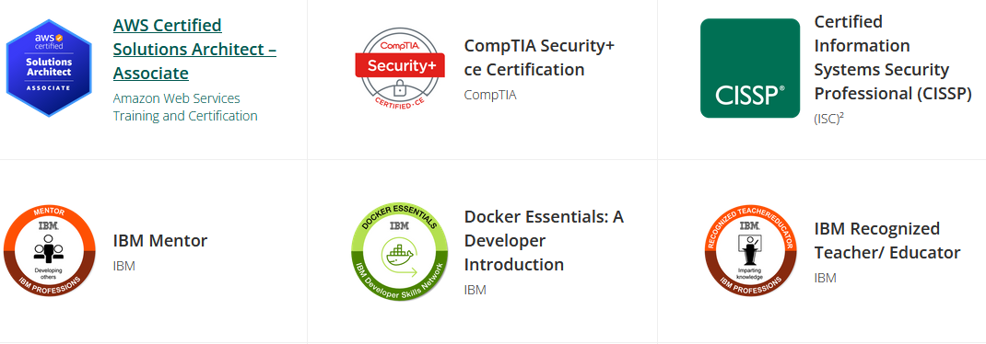
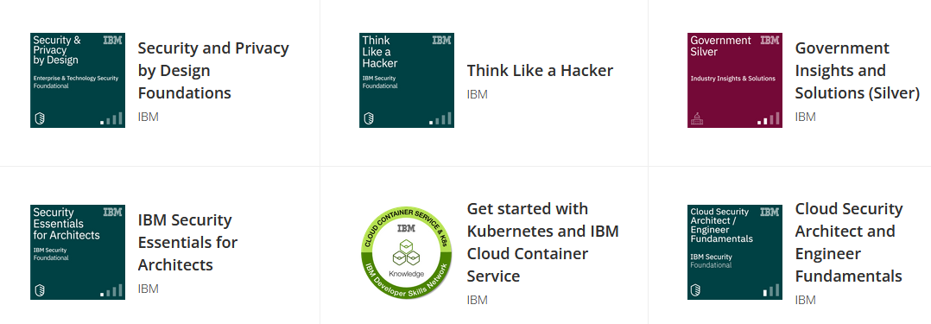
Hello World!
Tom Cope (https://tomcope.com)
Principal Consultant at Control Plane
Ex-CSO of Ava Security (now part of Motorola)
Security Engineer / SOC Analysis for UK leading asset manager
IAM SME at IBM
Working in Cyber Security ~12 years
Part time Security Researcher (CVE-2020-5014 + CVE-2021-29707)
CodeGate AI Write up coming soon!
Blue team by day, red team by night
Catch me at DEFCON later this year (Speaking @Malware Village)

Slide 3
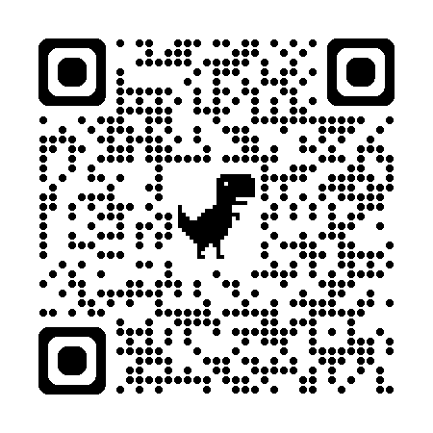
🔥🔥 FREE DOWNLOAD: 🔥🔥 https://control-plane.io/hackingkubernetes
ControlPlane - Who we are?
Cloud Native and Open Source security consultancy established in 2017. Our diverse culture empowers and develops individuals with talent and integrity.
Accustomed to work in highly-regulated environments and strategic programmes
Industry Leading
Kubernetes (first threat model for Financial Services User Group (FSUG)
Hacking Kubernetes O’Reilly, authors and Trainer
Defending Cloud Native - SANS, SEC 584 authors and trainers
Future Focussed
Linux Foundation’s Security Technical Advisory Group (co-chair, CNCF)
OpenUK (CISO, pro bono)
Community organisers and collaborators (i.e. KubeCon, CloudNativeCon)
@twitterhandle
ControlPlane - We leave it better than we found it
@controlplaneio

Slide 4
Our Cloud Native Security Consultancy Services
We help you Secure Kubernetes from supply chain and runtime attacks
Threat Model Subscription
Assurance & Penetration Testing
Security Audit and Architecture
Deep security analysis of Cloud Native environments from Dev. to Prod.
DevSecOps Delivery
Cloud Native & Open Source Integration
Develop & integrate for explosive platform growth & security resilience
Security Roadmap
Agile
Training
Threat Model
Cloud Native Engineering
Expert DevSecOps engineering for highly regulated environments
Discovery Workshop

Slide 5
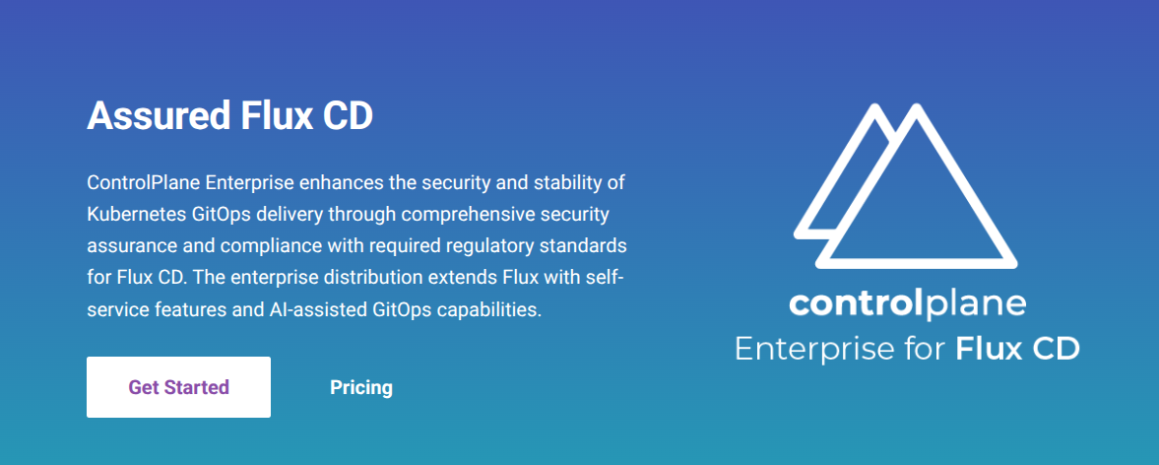
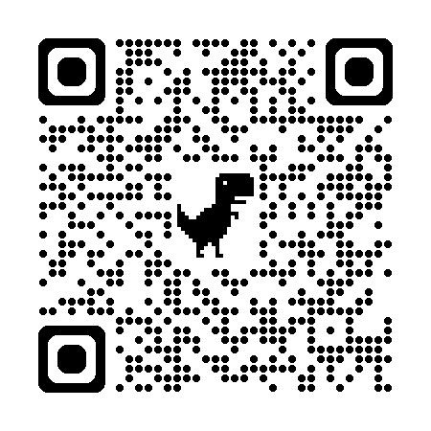
Come and see our booth!
https://github.com/fluxcd/flux2
https://control-plane.io/

Slide 6

IAM - Identity Access Management
The three A’s:
A - Authentication
A - Authorization
A - Audit
(AuthN)
(AuthZ)
Who are you?
Are you allowed todo that?
Make a note of it
"authorization" = American English "authorisation" = British English
Notes:
Today I’m going to talk to you about Identity and access management. This is the image I usualy see when I talk to people about IAM but do worry! I’m scared too. You can usually tell a good IAM engineer by their 100 yard stare and they twitch every time you mention “password policy”. We are going to talk about the three As….. the “z” here is from the american enlish and the “s” from the british which is difficult for me because I want to be accurate and use the Z since thats what the idenrty has settled on but I also want to use the “s” because I want to be right

Slide 7



Authorization - AuthZ
“Authorization is the process of determining what resources/actions a user or system is allowed to access/perform”
Policy
Access Granted
We will touch on soon…
Policy Enforcement Point (PEP)
AuthZ
Engine
(Policy Decision Point - PDP)
Step Up
Identity
Human / Machine
Context
Time
Day of the week
Risk - IP
Access Denied

Slide 8
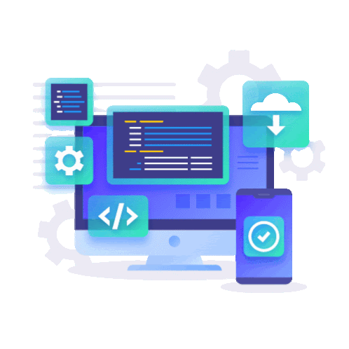

Where do we use Authorization?
BOTH
Business
Product
You are building your own custom Authorization application to solve a business need
Who can access your cloud?
Google Workspace permissions
Customer Database permissions
Internal Apps
Building product X and you need a permission system to enforcee Y
Roll your own! Or use a open source product / paid service
Notes:
Talk about the custom k8s port forward system we had at Ava what allows you to enter a business reason, get manager approval and then perform a port forward and all http calls were recorded for access to custom data

Slide 9
The Great Compromise
Easy of Use
Maintainability
Expressiveness of your policy language
Compatibility
Cost (both for services, transition and ongoing maintenance)
“Perfect is the enemy of good”
Voltaire

Slide 10
Two broad types of access control
Fine-Grained Access Control (FGA)
Coarse-Grained (CGA)
“I can delete all blog posts”
“I can delete only X blog post”

Slide 11

Lets talks types of access control!
Attribute-Based Access Control (ABAC)
Policy-Based Access Control (PBAC)
Role Based Access Control (RBAC)
Relationship-Based Access Control (ReBAC)
And then talk about implementation!

Slide 12
Attribute-Based Access Control (ABAC)
Authorization decisions are based on the presence or absence of tags
Subject / Resource (Humans, EC2 Instances, Applications etc) are associated with 0-n “Attributes” or tags:
project-y
infra-team
secret / restricted
Static or Dynamic:
Auto Scaling groups
Documents created with in a folder
Terraform resources
Users within a department

Slide 13
Attribute-Based Access Control (ABAC)
Attributes can be environmental such as:
in-work-hours
tuesday
Remote-connection
Attributes can be meta as well:
2fa-provided
new-device
Phishing-resistant-2fa-used
Attributes based on action:
create / delete
Transfer > £100
Could be used to trigger setup authentication
Commonly seen in Azure Conditional Access
Used to generate a risk score

Slide 14
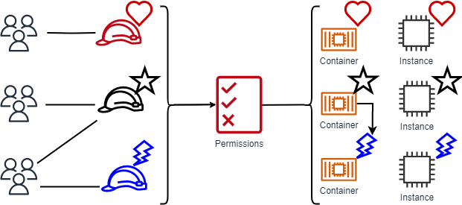
Attribute-Based Access Control (ABAC)
Ref: https://docs.aws.amazon.com/IAM/latest/UserGuide/introduction_attribute-based-access-control.html

Slide 15
Attribute-Based Access Control (ABAC)
Example policies:
Policy:
Policy:
infra-team -> project-y
Finance team
Remote Working
2FA-Provided
Known Device
->
Restricted documents

Slide 16
Attribute-Based Access Control (ABAC)
Advantages
Auto tagging of resources
Scales well with the business
Fewer Policies*
Linked with sources of truth (eg corporate directory or cloud environment)
Disadvantages
Not as fine grained (per object basis)
How many attributes?
Getting all the tags to stick, support for tagging

Slide 17
Policy-Based Access Control (PBAC)
“Policy-Based Access Control is an overarching authorization model where access decisions are determined by evaluating a set of defined policies”
These policies can be anything implemented in a variety of ways
Leads to a overloaded term

Slide 18
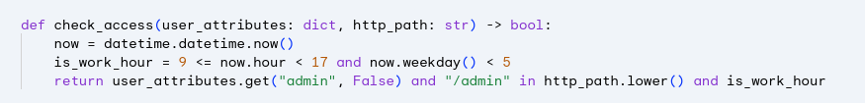
Policy-Based Access Control (PBAC)
As Code:
Only allow users with the “admin” attribute to access the “/admin” page during the working week

Slide 19
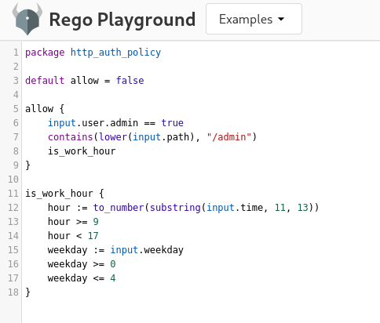
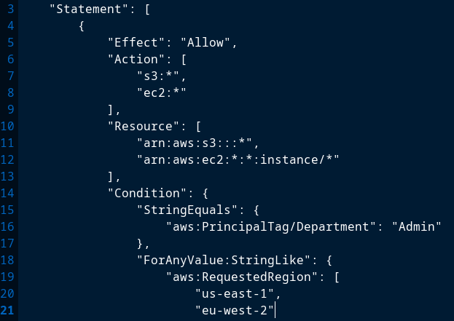
Policy-Based Access Control (PBAC)
In Code:
*examples only: please don’t use these policies in production

Slide 20
Policy Based Access Control (PBAC)
Advantages
Easy to review (with linters or human review)
Easy to audit (log inputs and policy decision)
Incredibly flexible
Can be very Fine-Grained
Disadvantages
Can get complex quickly
Lots of policy re-writes as the business grows (new system = new policy)
Performance of evaluating the policy
Does each team manage their own policy or a central team?

Slide 21

Role-Based Access Control (RBAC)
Actor
User -> “tom”
Machine -> “database_ec2”
Role
“admin”
Permissions
“add_users”
“bake_cake”
You’ve seen it everywhere:
Every SAAS, IAAS
AWS IAM Redefined Roles
Google Workspace

Slide 22
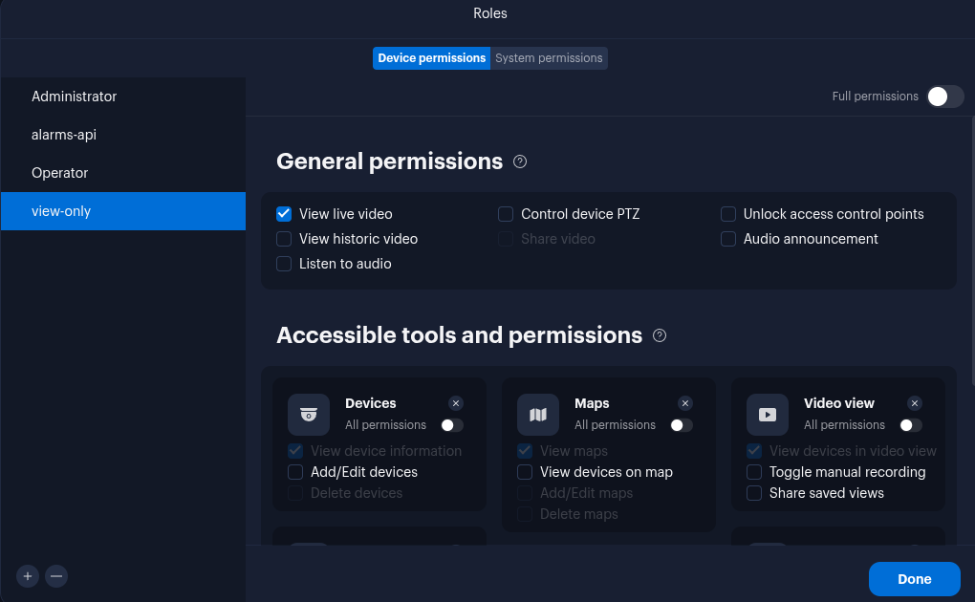
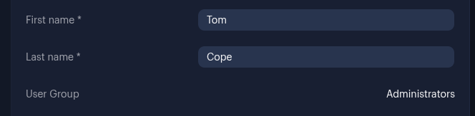
Role-Based Access Control (RBAC)
3. Permissions
CCTV System
Example
2. Role
User

Slide 23
Role-Based Access Control (RBAC)
Advantages
Easy to implement
Gets the job done for most use cases
Easy mental model -> “Finance” / “Infra”
Disadvantages
Does not scale well
Custom Roles = “Role Explosion”
Usually lacks context such as “time of day”
Lack fine grain permissions / not always in control of the permissions attached to a role (especially in SAAS)

Slide 24

Semantics
Rarely everything is so cut and dry
Attribute-Based Access Control (ABAC)
Theory
You need a policy engine to implement ABAC
Policy-Based Access Control (PBAC)
Role-Based Access Control (RBAC)
Style of Implementation

Slide 25

New Developments…
Who’s that new access control technique?
Its Google!

Slide 26
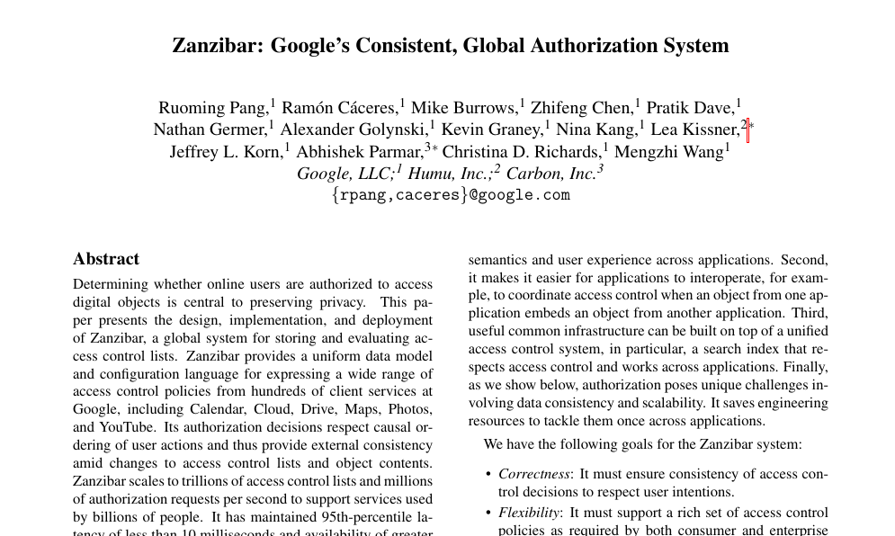
Google Zanzibar and the introduction of
Relationship-Based Access Control (ReBAC)
Zanzibar: Google’s Consistent, Global Authorization System
2019 {USENIX} Annual Technical Conference ({USENIX} {ATC} '19)}
Ref: https://research.google/pubs/zanzibar-googles-consistent-global-authorization-system/

Slide 27
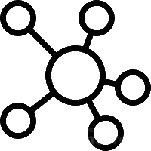
Zanzibar
Built by Google for Googles AuthZ Problems
Designed to be extremely fast, globally consistent, highly scalable and fault tolerant to human and system error
Built on top of Google Spanner Database
Introduced the concept of:
Relationship-Based Access Control (ReBAC)

Slide 28
Relationship-Based Access Control (ReBAC)
An authorization decision are based on direct or indirect relationship between entities.
Two separate components contained in a graph database like system:
Model
Defines “types” and “relations”
Tuples
Data within the database which provides the relationships
Ref: auth0 fga playground https://play.fga.dev/sandbox/?store=slack

Slide 29
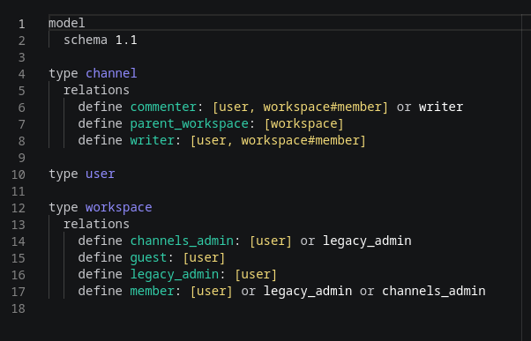
Relationship-Based Access Control (ReBAC)
Model - Like a database scheme
Different Types
Relations - How the types can relate to each other
------------------------------------------------------
Using slack permissions as a example
“Channel” and “user” can be related by a “writer” relationship
“Workspace” and “user” can be related by a “member” relationship
Ref: auth0 fga playground https://play.fga.dev/sandbox/?store=slack

Slide 30
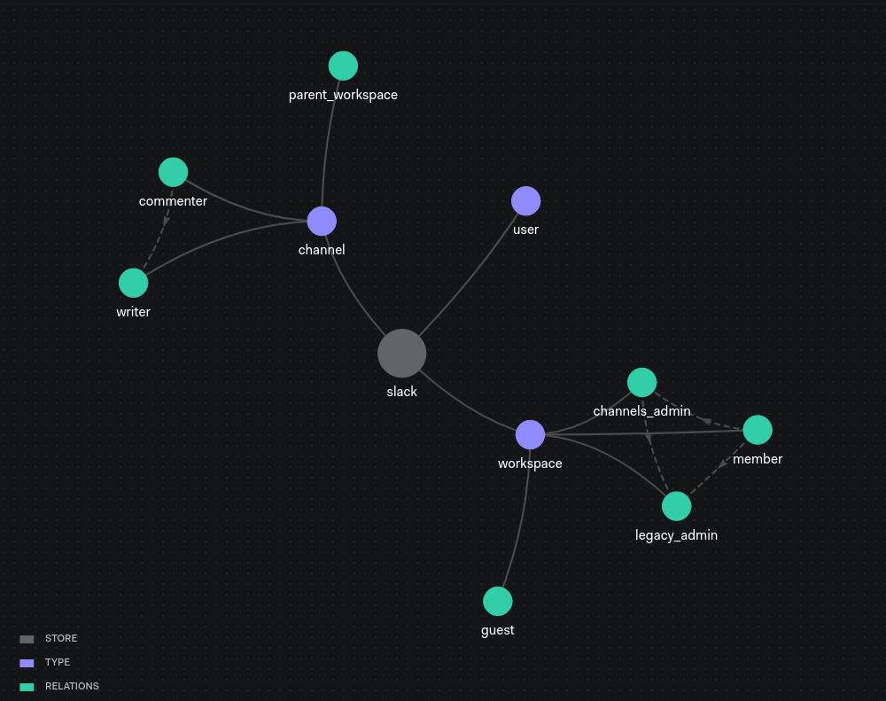
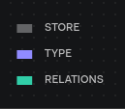
The model/scheme describes the relationships which CAN exist. The Tuples in the database explain which DO exist
Ref: auth0 fga playground https://play.fga.dev/sandbox/?store=slack

Slide 31
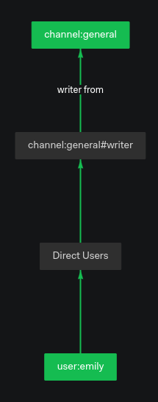
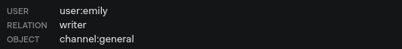
is user:emily related to channel:general as writer?
Tuple (stored in database)
Ref: auth0 fga playground https://play.fga.dev/sandbox/?store=slack

Slide 32
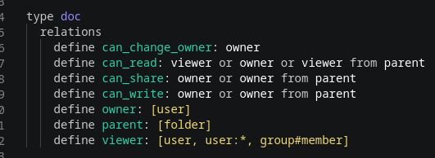
Relationship-Based Access Control (ReBAC)
Google Drive Example
Types
Relationships

Slide 33
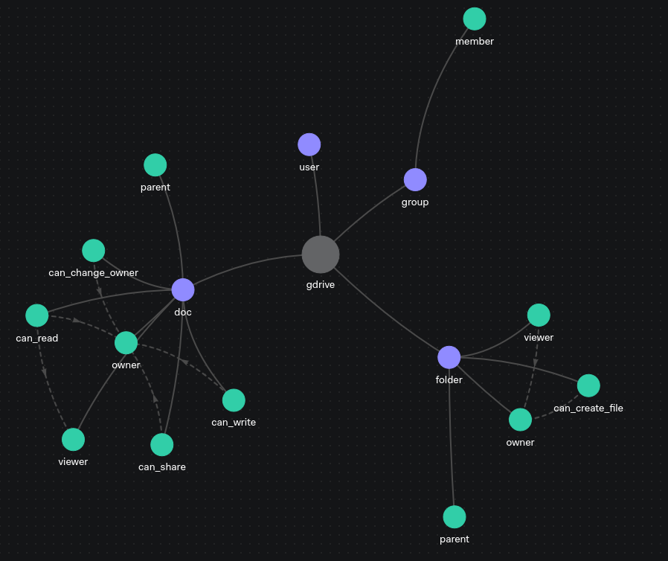
Ref: auth0 fga playground https://play.fga.dev/sandbox/?store=slack

Slide 34
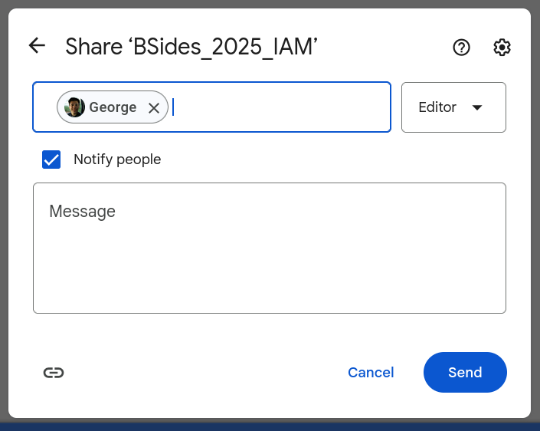

Tuple
USER = user:george
RELATION = editor
OBJECT = doc:BSides_2025_IAM
INSERT

Slide 35


can_read
BSides_2025_IAM
tuple,tuple,tuple,tuple,tuple,tuple,tuple,tuple,tuple,tuple,tuple
model
https://docs.google.com/presentation/d/1mZbSLRU21KjD5D8Ymc05ut-hX_rKt6fcUJVvl2FxgZQ/edit?usp=sharing
can user:george can_read doc:BSides_2025_IAM?

Slide 36
Relationship-Based Access Control (ReBAC)
Advantages
Expressiveness and Flexibility
Scale
Dynamic
Fast
Supports Reverse Indices: ReBAC can easily answer questions like "Who has access to this particular resource?"
Support for conditional relationships like “time of day” (coming soon*)
Disadvantages
Big “startup” cost to implement
Duplication of business data -> tuples
Few solutions out there
Auditing - dynamic nature of ReBAC policies and relationships
Modeling relationships can be complicated

Slide 37

That's all the theory!
Let's talk implementation!
For building authz into your own applications and integrating open source projects into your business

Slide 38
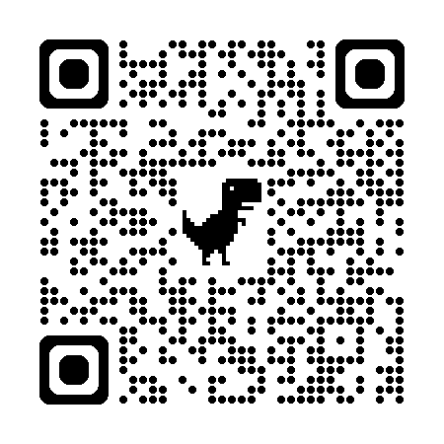


Relationship-Based Access Control (ReBAC)
Implementation
https://authzed.com/
Made by Ex-Googlers
Inspired by Zanzibar
Open Source Project, self host
Or Cloud hosted paid product
https://github.com/authzed/spicedb

Slide 39

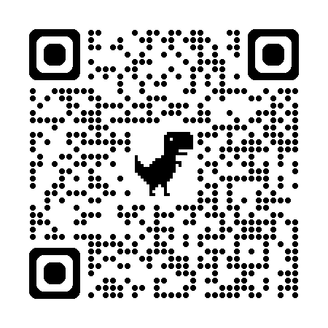

Relationship-Based Access Control (ReBAC)
Implementation
OpenFGA: Fine-Grained Authorization
https://openfga.dev/
https://github.com/openfga/openfga
Initially developed by Auth0/Okta
Inspired by Zanzibar
Open Source Project

Slide 40
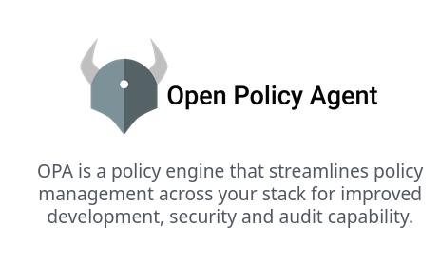
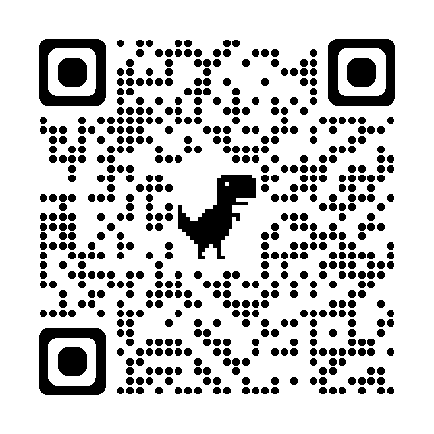
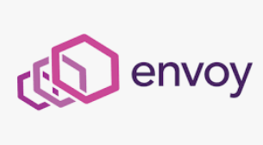
Policy-Based Access Control (PBAC)
https://www.openpolicyagent.org/
Policies are written in Rego
Can read data from external sources to make policy decisions
Very widely supported
Gatekeeper for Policy Controller for Kubernetes
Envoy proxy for easy access proxies, API authz or zero trust proxies
Great developer support and SDKs

Slide 41
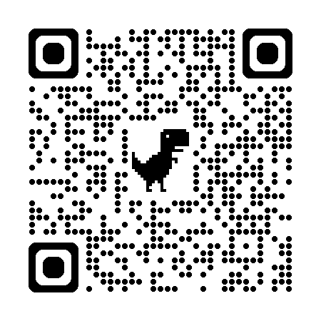

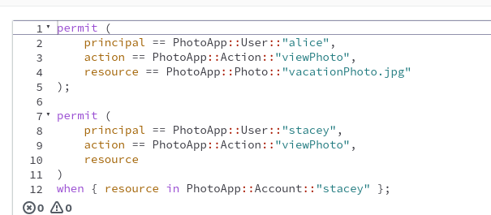
Policy-Based Access Control (PBAC)
https://www.cedarpolicy.com/
Open Sourced by Amazon
Based on AWS IAM
Ref: https://aws.amazon.com/about-aws/whats-new/2023/05/cedar-open-source-language-access-control/

Slide 42
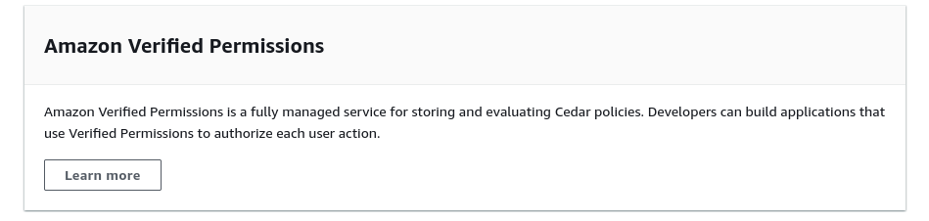
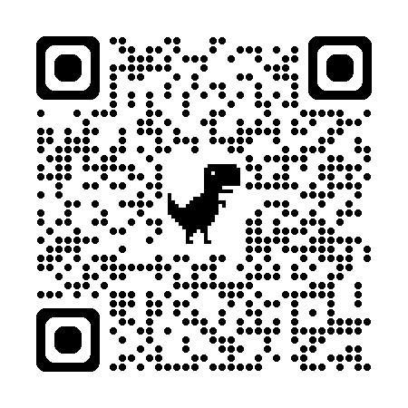
Policy-Based Access Control (PBAC)
Good for if your building your own product!
Ref: https://aws.amazon.com/about-aws/whats-new/2023/05/cedar-open-source-language-access-control/

Slide 43
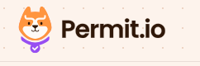
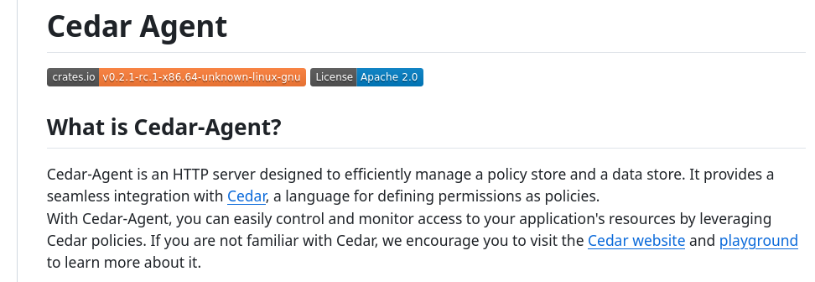
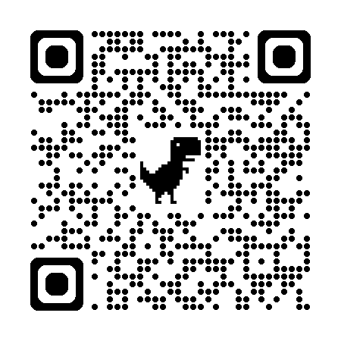
Policy-Based Access Control (PBAC)
https://www.permit.io/
Inspired by Cedar
https://github.com/permitio/cedar-agent
Open source Project
Paid Cloud Service
Ref: https://www.permit.io/blog/oss-aws-cedar-is-a-gamechanger-for-iam

Slide 44
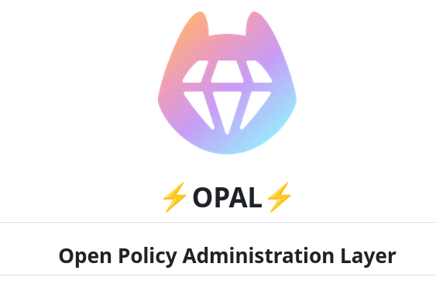
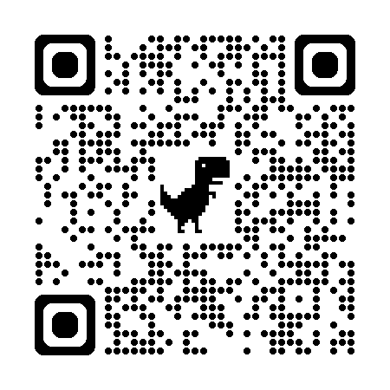
Policy-Based Access Control (PBAC)
Sister Project
https://github.com/permitio/opal
OPAL is an administration layer for Policy Engines such as Open Policy Agent (OPA), and AWS' Cedar Agent detecting changes to both policy and policy data in realtime and pushing live updates to your agents. OPAL brings open-policy up to the speed needed by live applications.
Ref: https://www.permit.io/blog/oss-aws-cedar-is-a-gamechanger-for-iam

Slide 45
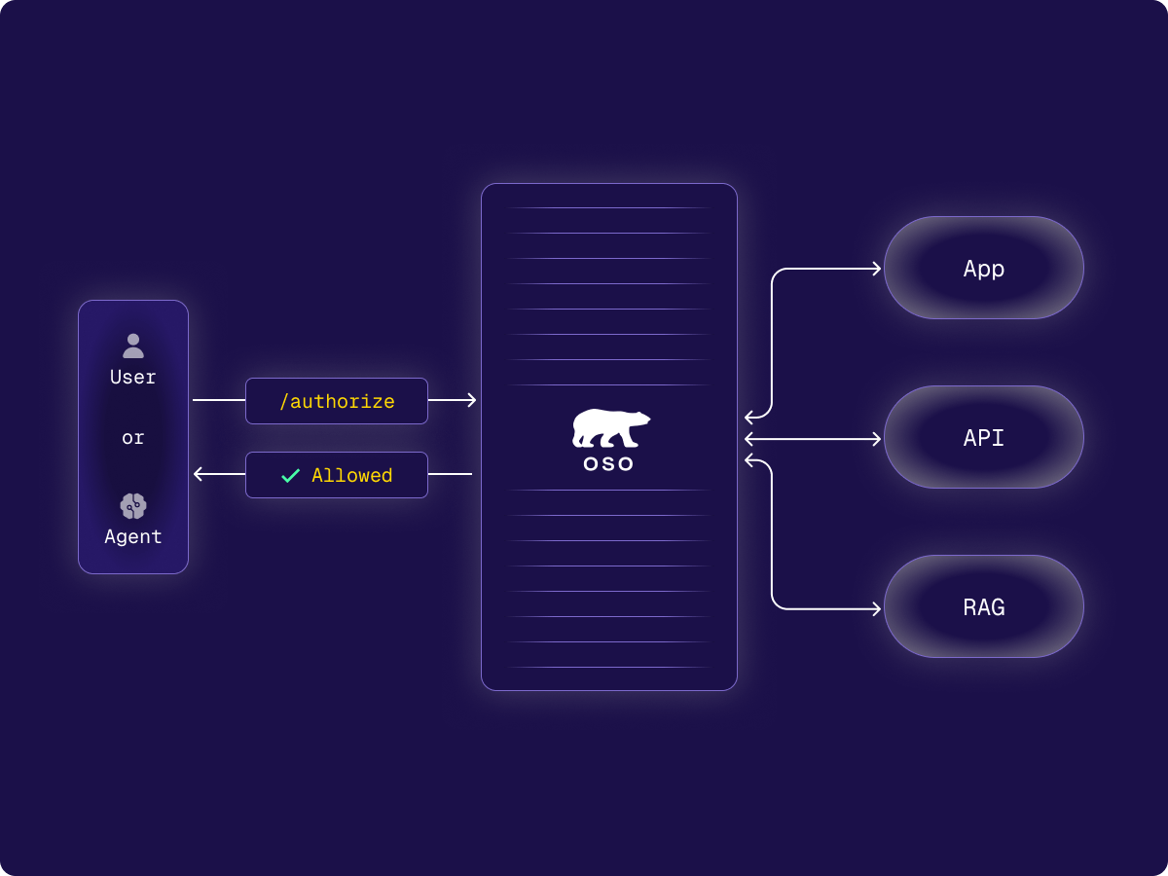
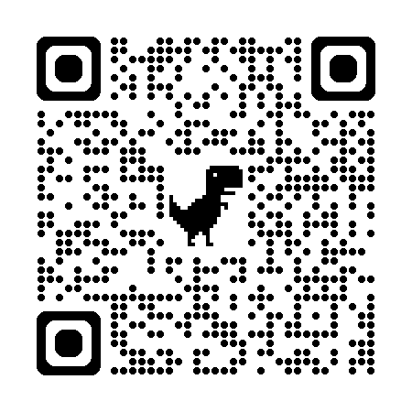
Policy-Based Access Control (PBAC)
https://www.osohq.com/
“Oso is authorization as a service”
Paid Cloud Service
Cloud Only (on prem soon ™ )
Integrates well with existing data sources
Opinion: better data model than Zanzibar
Supports:
RBAC
ReBAC
ABAC

Slide 46
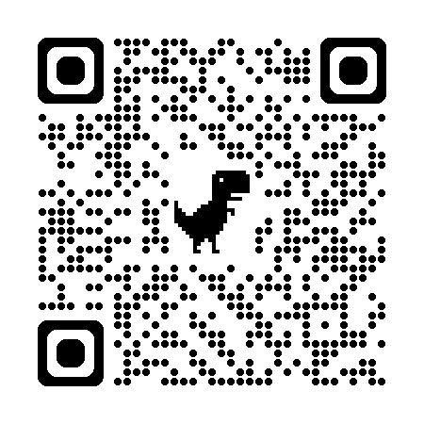
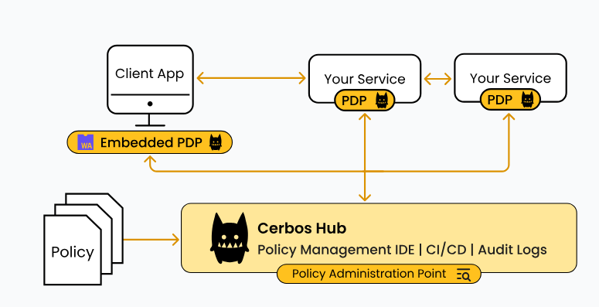
Policy-Based Access Control (PBAC)
https://www.cerbos.dev/
https://github.com/cerbos/cerbos
Authorization engine is open source
All on prem
Supports:
RBAC
ABAC
Cloud offering
“Cerbos Hub”
Policy Management IDE
Centralised Audit Logs

Slide 47
TODO - https://casbin.org/

Slide 48
The Great Compromise - Keep a decision log!
Easy of Use
Maintainability
Expressiveness of your policy language
Compatibility
Cost (both for services, transition and ongoing maintenance)
“Perfect is the enemy of good”
Voltaire

Slide 49

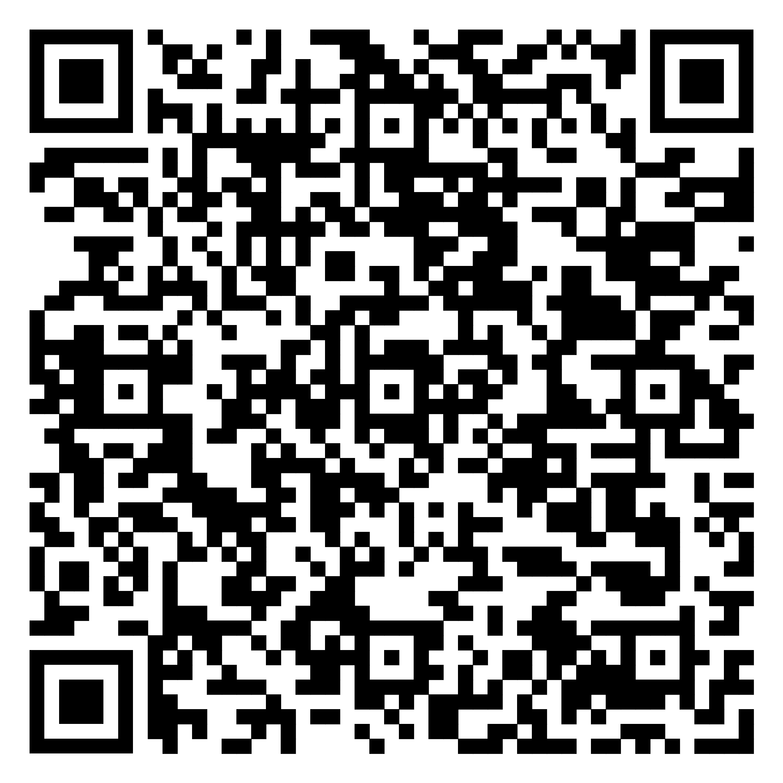

Thank you!
Any questions?
My Website ->
<- Slides
Add me on Linkedin ->

